Slide 1
Art 111 Quiz 3
Instructions: You will have 30 minutes total in class for this part of the quiz. No notes may be used. 1) Select three artworks from this slide show that best represent the hybrid identity of artworks in the post-Conquest era.
2) Choose artworks that we have read articles about and include information from those articles in your short essays about the artwork.
3) Chose artworks that represent the broadest chronological range of post-Conquest art we have covered.
4) Choose only ONE artwork from Gauvin Bailey’s essay.
**Identify the names of the authors and titles of the relevant readings and full identification of the artwork: name of the artist, title, date, medium (what it’s made out of)
**Describe how the artwork is a hybrid (mestizo) in form and content. Form would include the formal elements of art and medium. Content is the subject of the work plus its meaning

Slide 2
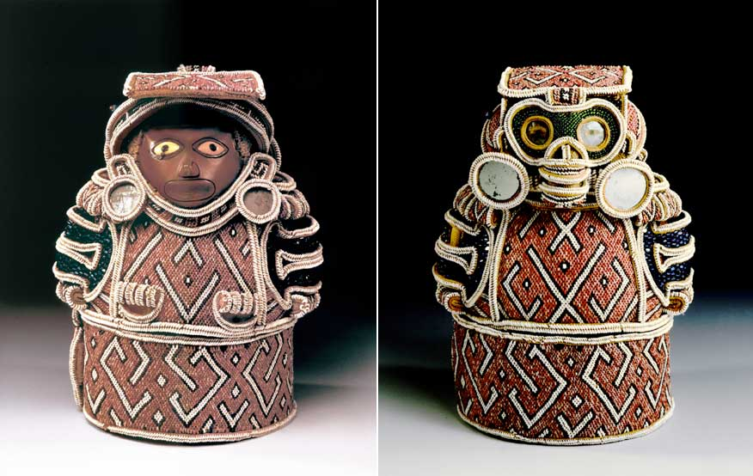

Slide 3
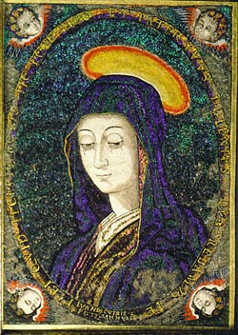

Slide 4
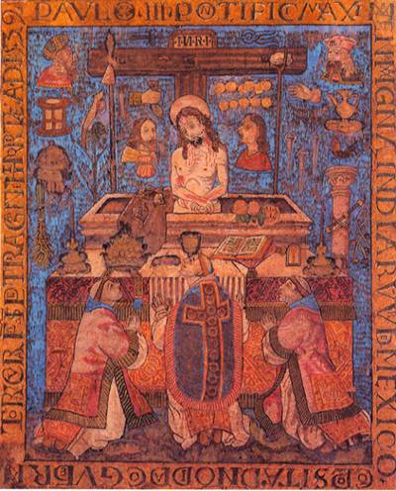

Slide 5
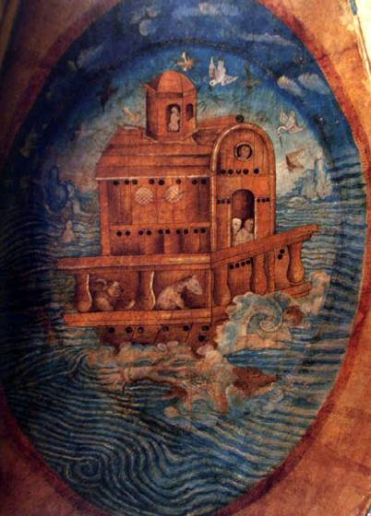

Slide 6
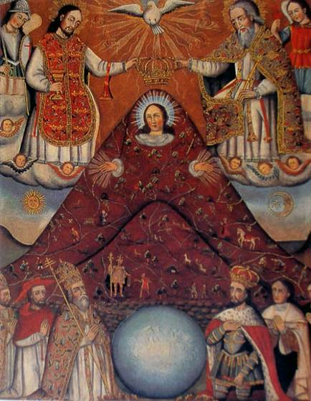

Slide 7
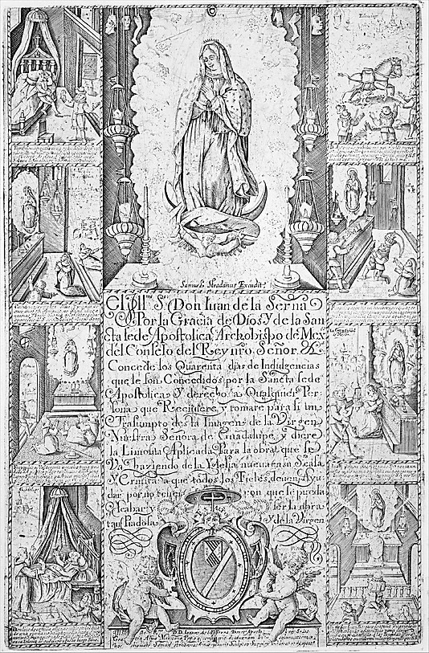

Slide 8
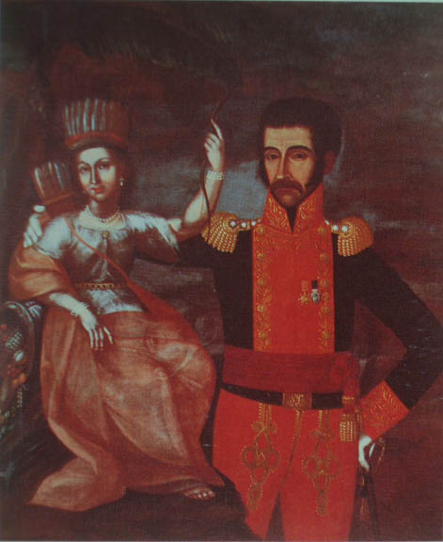

Slide 9
